Slide 1

Banking Dataset Classification
Predicting if the client will subscribe to a term deposit.

Slide 2
Business Problem
There has been a revenue decline in the Portuguese Bank, and they would like to know what actions to take. After investigation, they found that the root cause was that their customers are not investing enough for long term deposits. So, the bank would like to identify existing customers that have a higher chance to subscribe for a long-term deposit and focus marketing efforts on such customers.

Slide 3
Data Science Problem
Machine Learning is utilized in this scenario to analyze and predict customer behavior, specifically targeting those likely to subscribe to a term deposit. The decline in revenue due to a lack of long-term investments can be addressed by identifying patterns in customer data that correlate with the likelihood of subscribing to term deposits. Using ML algorithms can help in efficiently processing large volumes of customer data, uncovering insights that are not immediately apparent, and automating the prediction process to assist in making data-driven marketing and business decisions.
The task is to predict whether a bank's customers will subscribe to a term deposit, which is a binary classification problem.
The data consists of historical customer information from the bank, which includes demographic details, account information, and past interactions with the bank.
Performance metrics could include accuracy, precision, recall, F1-score.

Slide 4
Dataset
The data is related to direct marketing campaigns of a Portuguese banking institution. The marketing campaigns were based on phone calls. Often, more than one contact to the same client was required, in order to access if the product (bank term deposit) would be subscribed ('yes') or not ('no') subscribed.

Slide 5
EDA
Age: The average age of the bank's clients in this dataset is around 40 years old, with the youngest being 17 and the oldest 98. Most clients are in their 30s to 40s, which is typical for a working and economically active population.
Duration: The average duration of the last contact with the clients was about 258 seconds, but there's a big range, from just a few seconds (10 seconds) to over an hour (4918 seconds). This suggests there's a lot of variation in how long the bank's employees are talking to clients.
Campaign: On average, a client was contacted about 2.5 times during the current campaign, with a maximum of 56 times. This could imply that while some clients need more persuasion, the bank doesn't usually go beyond a handful of contacts.
Pdays: The '999' value indicates that many clients were not previously contacted, which aligns with the 'previous' column average being close to zero. This means the current campaign might be the first direct marketing interaction for most clients.
Previous: The low average (about 0.17) suggests that there were very few contacts with clients before the current campaign. This could mean the bank has not been very aggressive in its past marketing efforts or is reaching out to new clients.

Slide 6
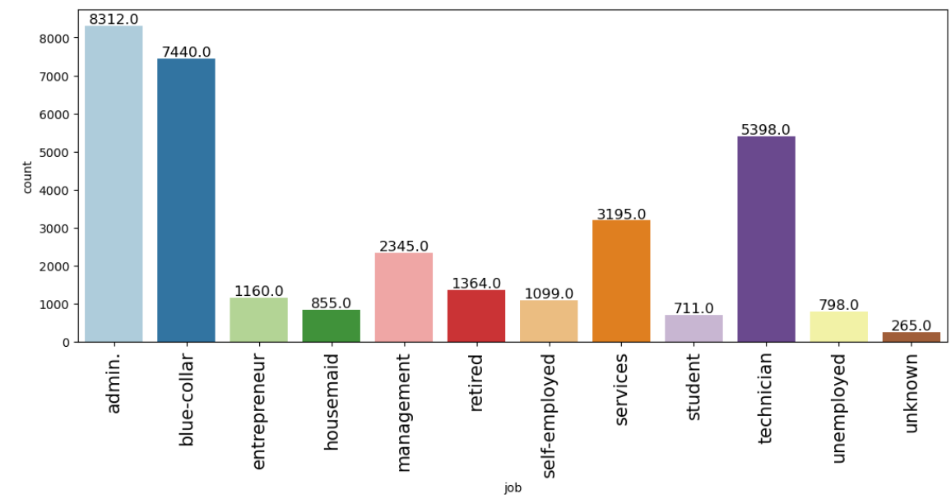
Cont.
The bar chart shows the job categories of the bank's clients. 'Admin.' and 'blue-collar' are the most common jobs, with a lot of clients working in these roles. 'Student', 'unemployed', and 'unknown' categories have the fewest numbers, indicating they make up a smaller portion of the bank's clientele.

Slide 7
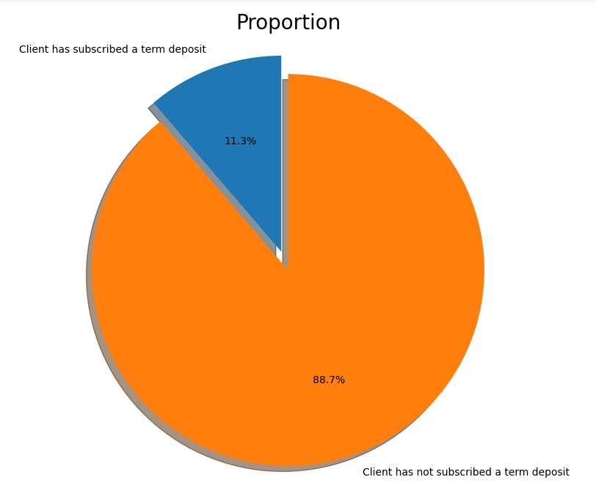
Cont.
This pie chart shows that the actual distribution of classes is itself imbalanced for the target variable.
Only ~11% of the customers in this dataset have actually subscribed a term deposit.

Slide 8
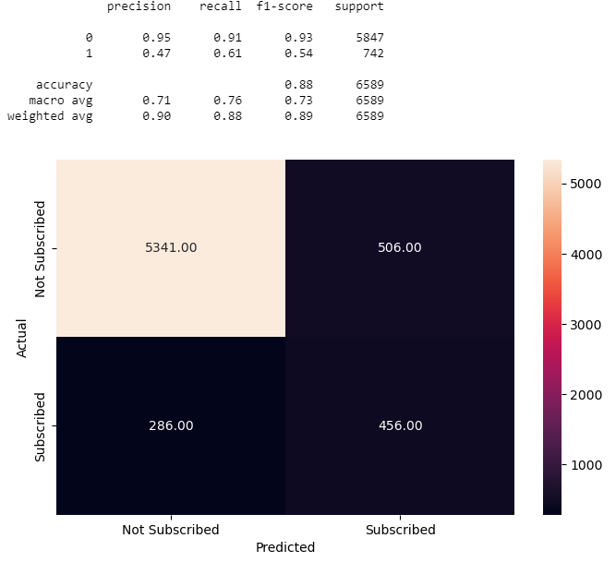
Models
Artificial Neural Network
The model has been evaluated on the test data and shown below:

Slide 9
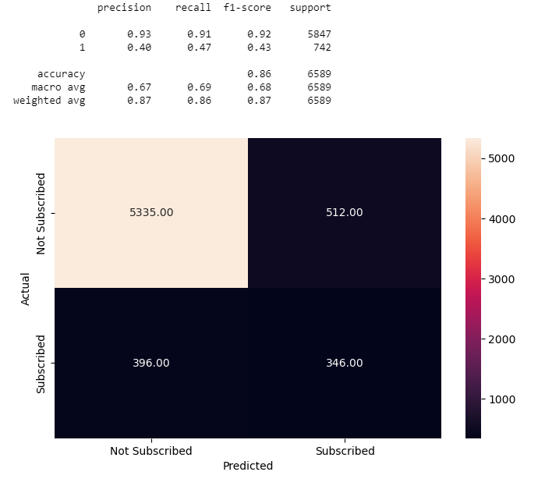
Cont.
Building a Decision Tree Model
The model has been evaluated on the test data and shown below:

Slide 10
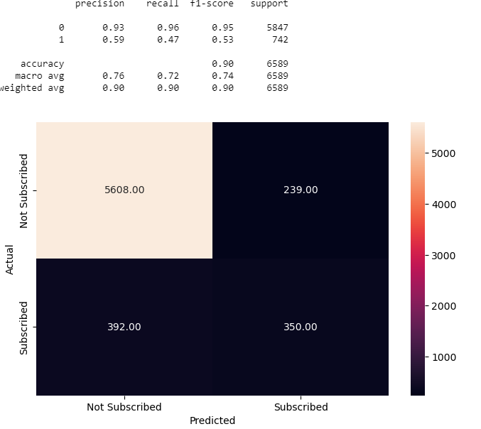
Cont.
Building a Random Forest Classifier
The model has been evaluated on the test data and shown below:

Slide 11
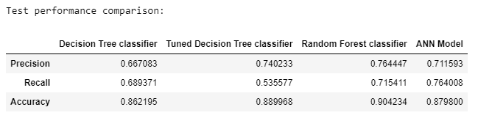
Model Comparisons
It can be observed that the Random Forest classifier is outperforming other models with an accuracy of 90%.

Slide 12
Conclusion & Feature work
The best-chosen model is Random forest classifier because it has outperformed other models in comparison.
The future studies must improve the accuracy and compare different algorithms. The model should be trained on large dataset for better generality of results.

